Slide 1
BIOM200 Bioinformatics
Eric Van Nostrand
Merck Fellow of the Damon Runyon Cancer Research Foundation
Yeo Lab, UCSD
10/03/2017

Slide 2
Outline
How do I know if my dataset is ‘good’? (Q/C metrics)
RNA-seq
Binding assays (DNA: ChIP-seq, RNA: CLIP-seq)
What are key considerations for experimental design
RNA-seq – batch effects
ChIP-seq, CLIP-seq – input normalization
How can genomics data inform biology
ChIP/RNA-seq overlap to identify direct transcriptional regulation
CLIP/RNA-seq overlap identifies RNA processing regulation
Integrated analyses to reveal novel mechanisms

Slide 3
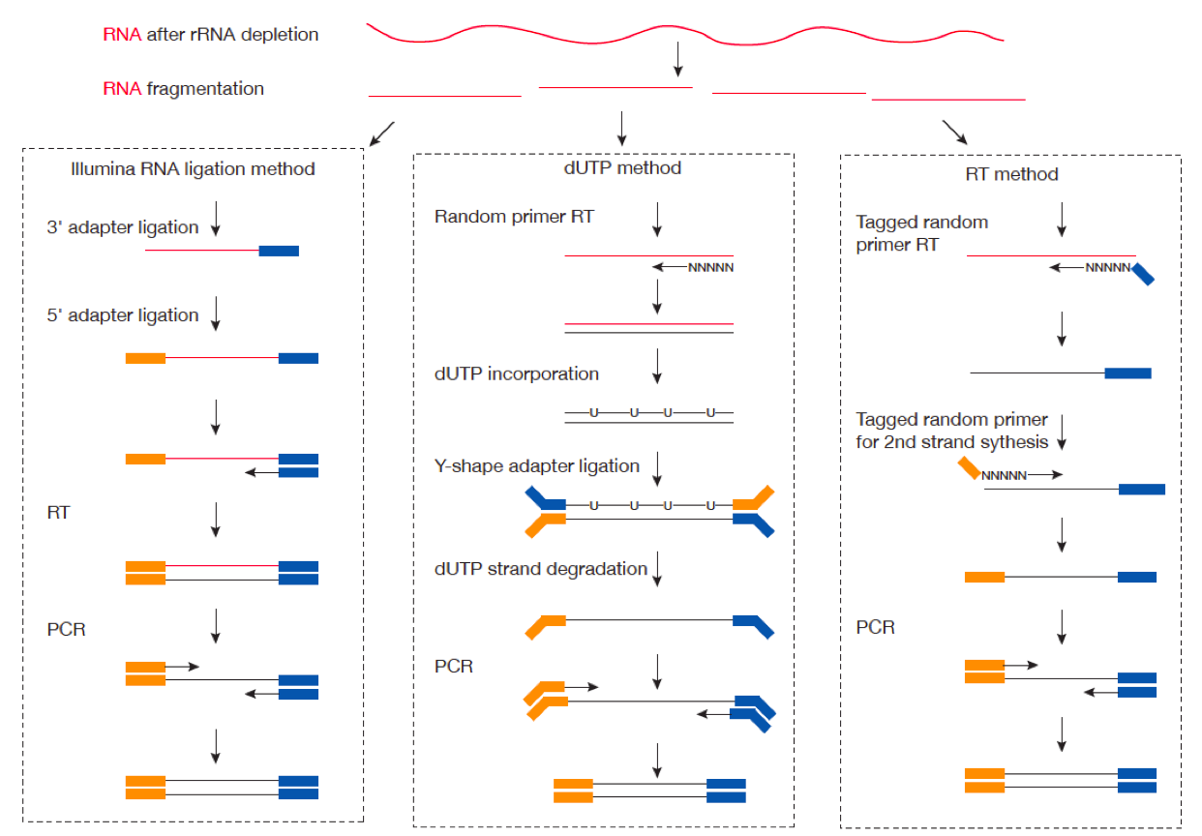
RNA-seq: a quick reminder

Slide 4
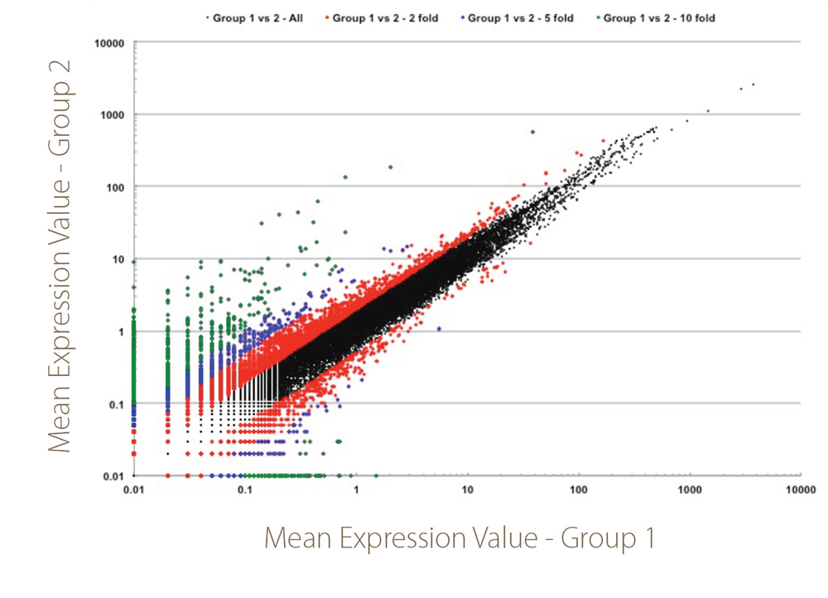
Identifying differential expression from RNA-seq
DESeq2 – quantitative analysis of RNA-seq data to identify differential expressed genes

Slide 5
What makes an RNA-seq experiment ‘good quality’?

Slide 6

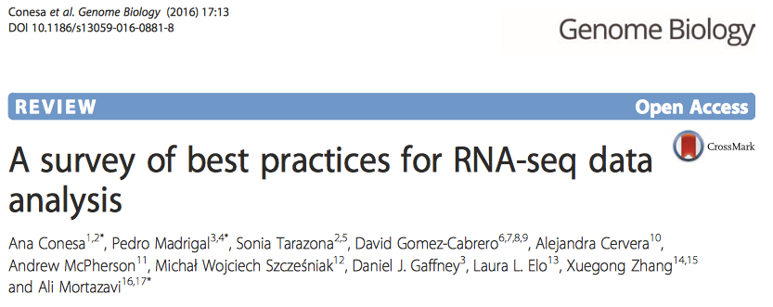
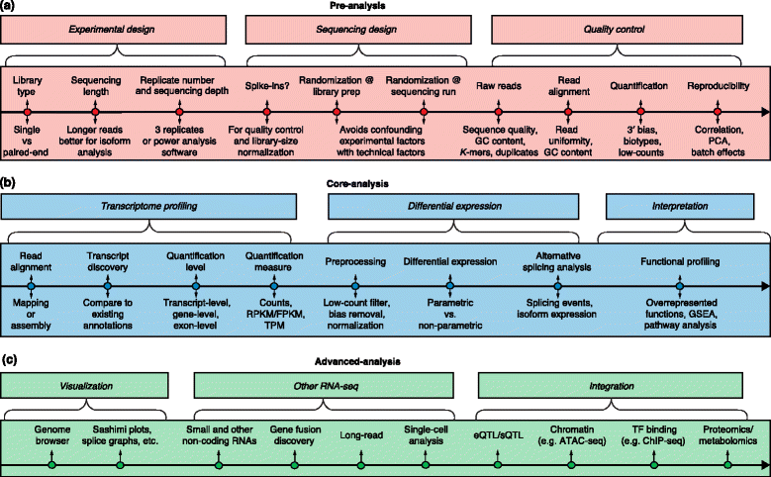
RNA-seq: standards & best practices
https://www.encodeproject.org/rna-seq/long-rnas/
Each replicate should have 30 million aligned reads, although older projects aimed for 20 million reads.
Replicate concordance: the gene level quantification should have a Spearman correlation of >0.9 between isogenic replicates and >0.8 between anisogenic replicates (i.e. replicates from different donors).

Slide 7
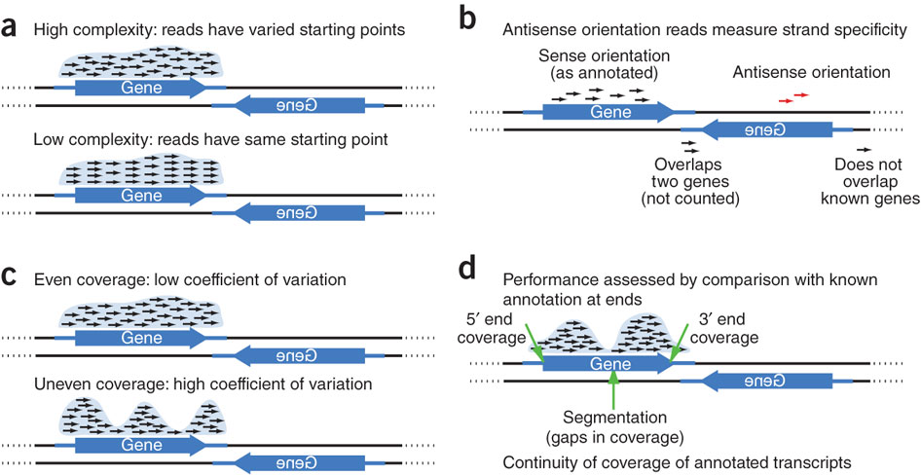
Considering RNA-seq quality

Slide 8
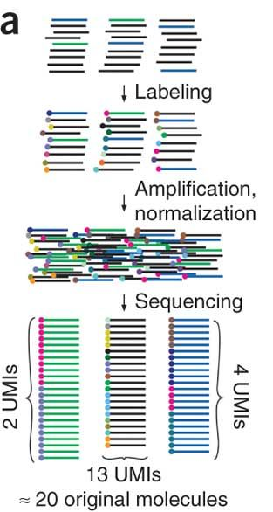
Removing PCR duplicates with Unique Molecular Identifiers (UMIs)
Amplification by PCR creates multiple copies of each molecule
Too little starting material leads to ‘bottlenecking’ – pileup of PCR duplicate reads at specific positions
Can be detected and removed by adding Unique Molecular Identifiers (UMIs) = random barcodes prior to PCR
Kivioja T., et al. 2011

Slide 9
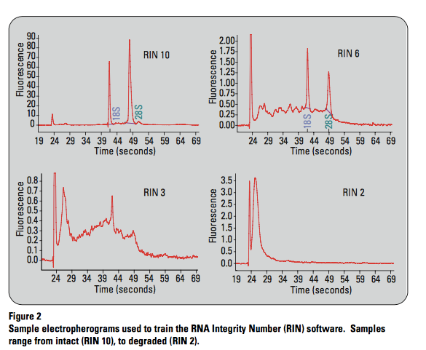
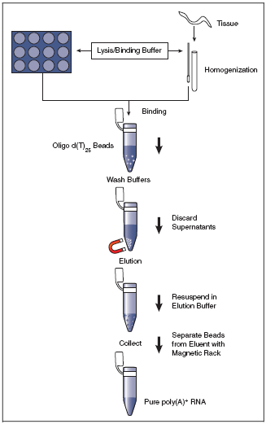
RNA quality can dramatically effect RNA-seq coverage
mRNA only -> PolyA selection
(All mRNAs are polyadenylated at the 3’ end – can use d(T)₂₅ beads to select)

Slide 10
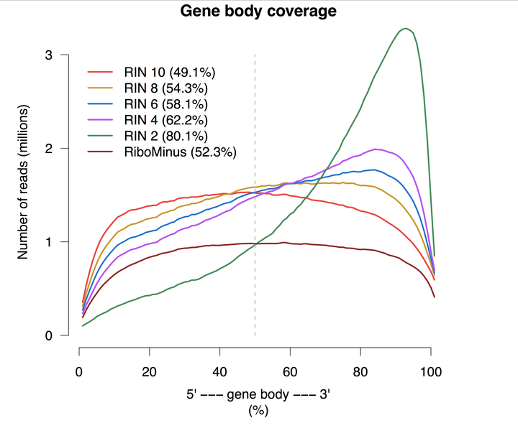
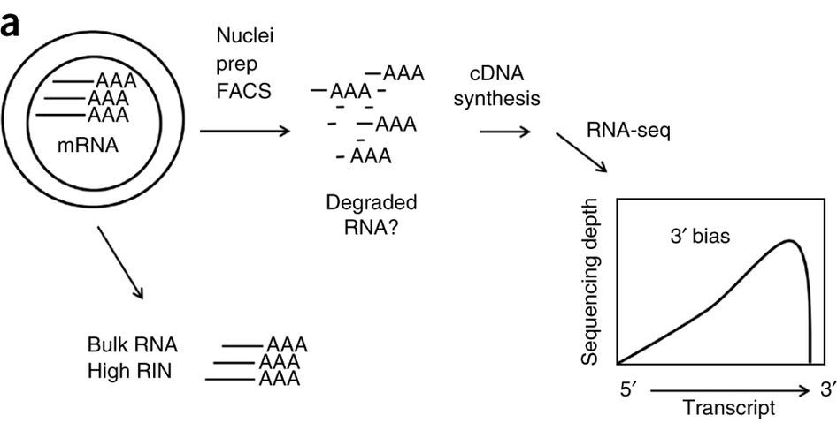
RNA quality can dramatically effect RNA-seq coverage
Krishnaswami et al. 2016
Sigurgeirsson et al. 2014

Slide 11
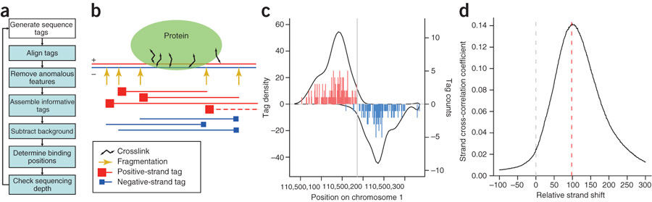
Binding site-identifying assays (ChIP, CLIP)
Goal: identify (short) regions of significantly enriched signal
ChIP: TF binds double-stranded DNA, which can aid in identifying true peaks (look for stereotypical spacing)
Kharchenko et al. 2008

Slide 12
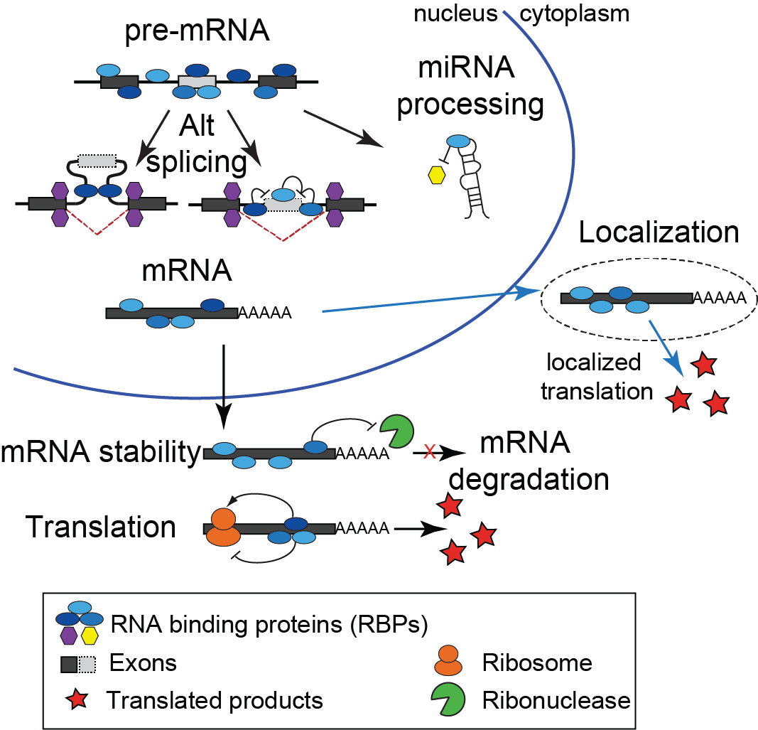
Each step of RNA processing is highly regulated
RNA binding proteins (RBPs) recognize specific and general RNA motifs to regulate RNA processing steps
Estimated >1000 RBPs in human
RNA processing plays critical roles in development and human physiology
Mutation or alteration of RNA binding proteins plays critical roles in disease
Stephanie Huelga

Slide 13
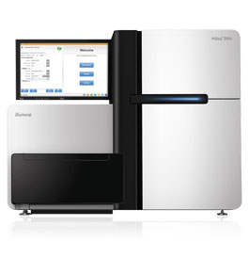
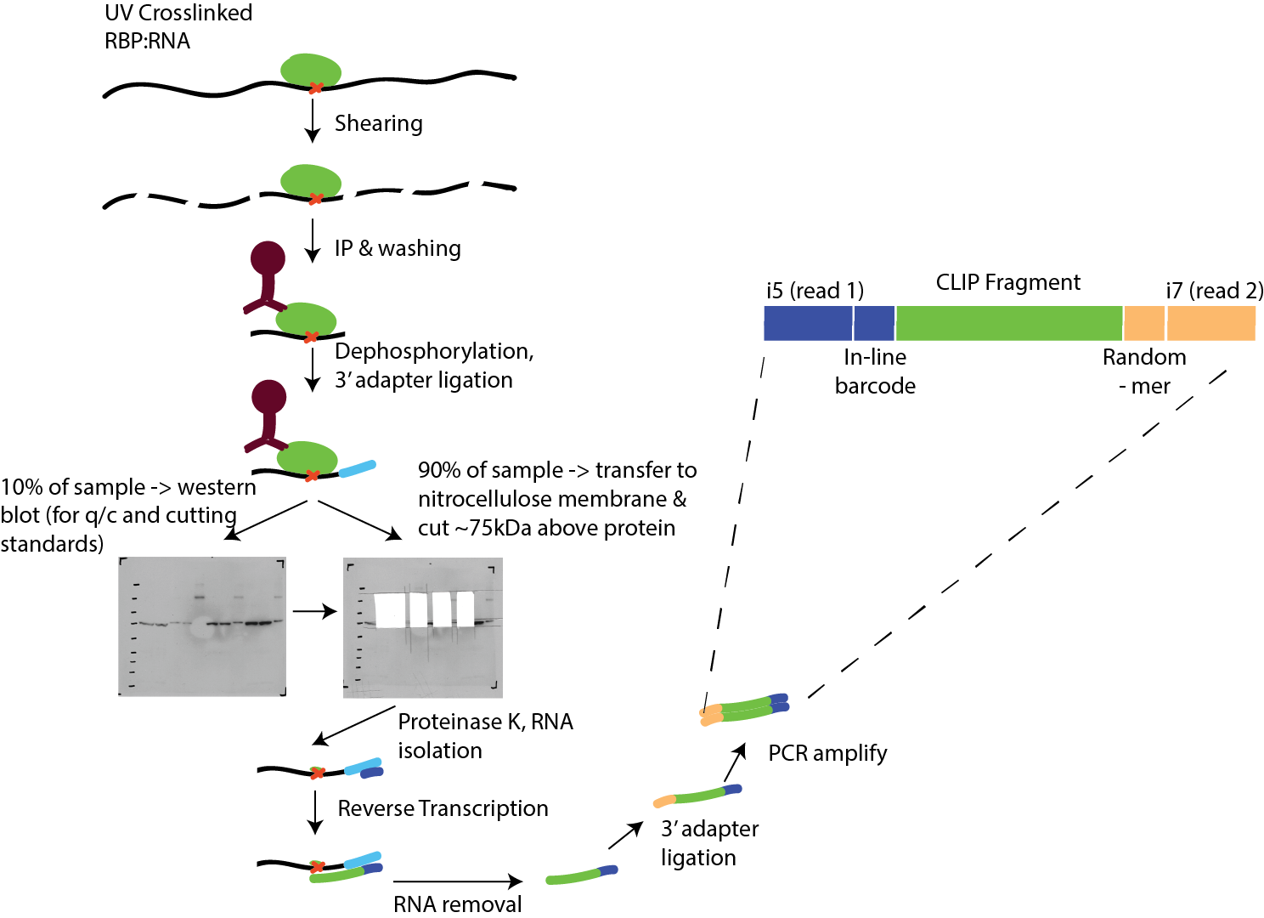
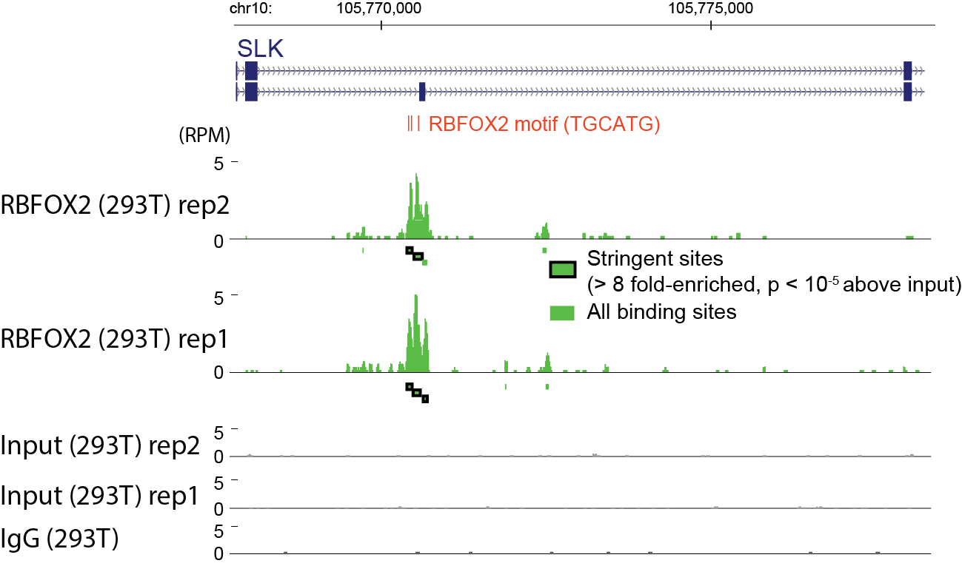
Identification of RNA binding protein targets by enhanced CrossLinking and ImmunoPrecipitation (eCLIP-seq)
High-throughput sequencing
Data processing & peak calling
Van Nostrand, et al. Nature Methods (2016)

Slide 14
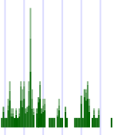
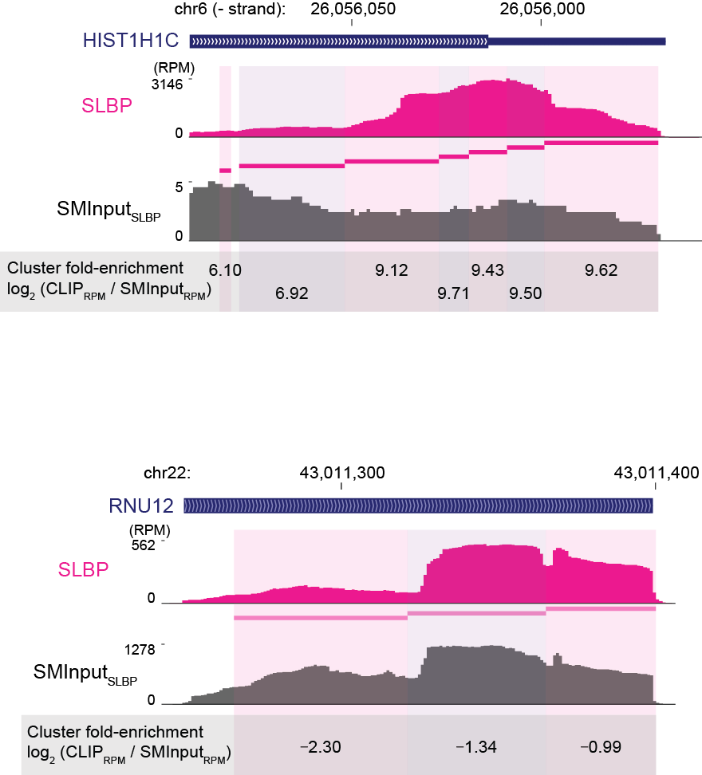
CLIP-seq peak identification
CLIP: RNA transcripts can vary thousand-fold in expression level
=> Identify regions of enrichment above transcript baseline, then use paired input to identify true binding sites
Identify potential
clusters
Region 1
Region 2
FDR calculation:
For each region identify cutoff where 5% of loci are above cutoff
Determine cluster significance above transcript background
Region 1
Region 2
Obtain significant clusters
Peak Identification:
Fit smoothing splines to data
Identify peak center as local maxima above FDR cutoff
Input normalize each cluster to identify CLIP-enriched peaks
Input Normalization:
For each cluster, count reads in IP and paired input -> determine enrichment and significance

Slide 15
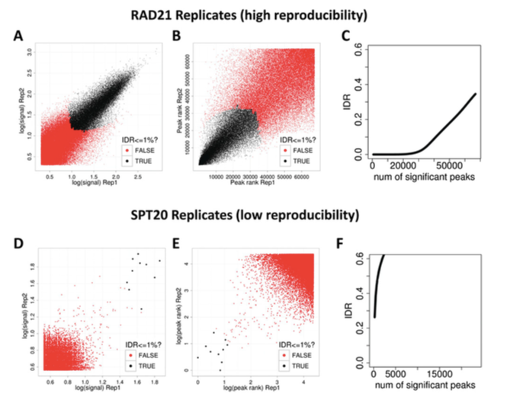
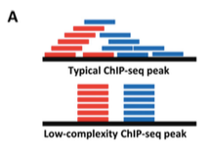
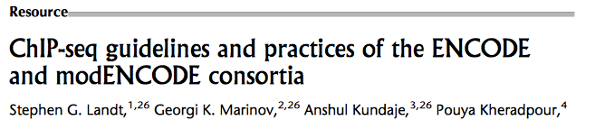
Assaying quality of ChIP/CLIP experiments
Binding assays (ChIP-seq for transcription factors, CLIP-seq for RNA binding proteins) have their own quality metrics

Slide 16
Outline
How do I know if my dataset is ‘good’? (Q/C metrics)
RNA-seq
Binding assays (DNA: ChIP-seq, RNA: CLIP-seq)
What are key considerations for experimental design
RNA-seq – batch effects
ChIP-seq, CLIP-seq – input normalization
How can genomics data inform biology
ChIP/RNA-seq overlap to identify direct transcriptional regulation
CLIP/RNA-seq overlap identifies RNA processing regulation
Integrated analyses to reveal novel mechanisms

Slide 17
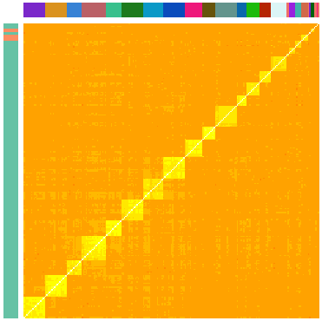
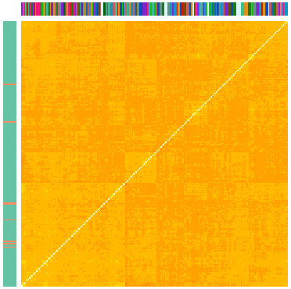
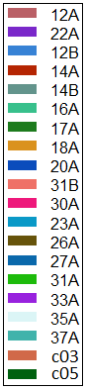
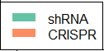
Batch effects and batch correction
Subtle differences in experimentation (enzyme age, room temperature, kit details, etc) can cause subtle changes in resulting data
These are often observed as ‘batch effects’ where samples cluster better within their batch than with replicates performed in other batches
Correlation in splicing changes
Before Normalization
After Normalization
Batch
Batch
Batch
Sample Type
Sample Type

Slide 18
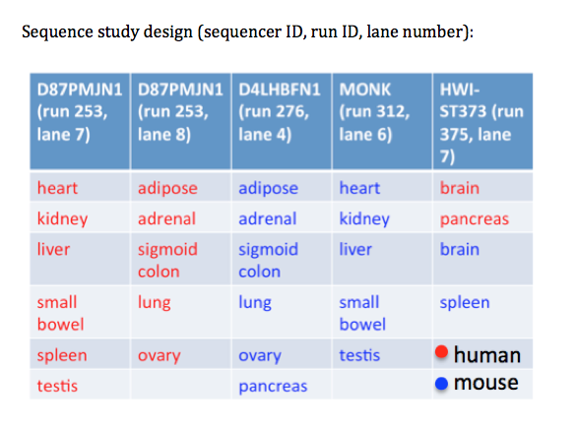
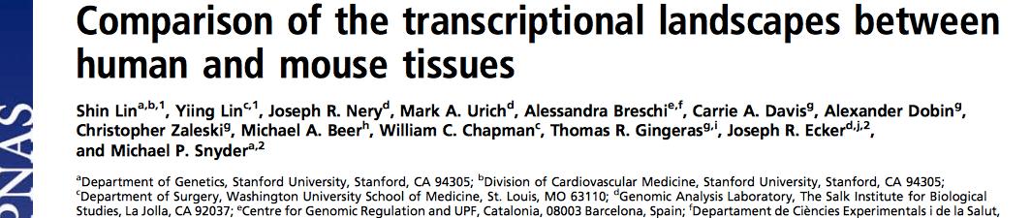
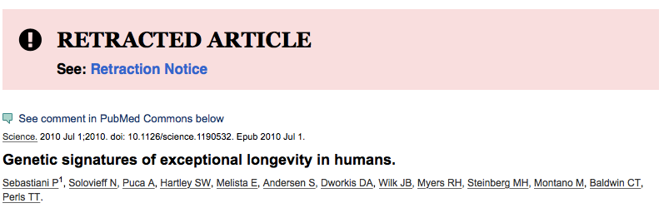
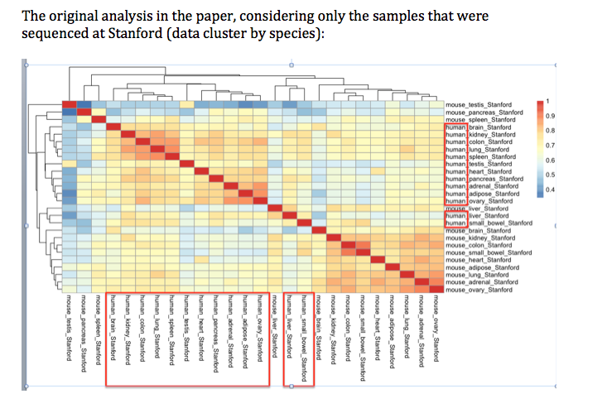
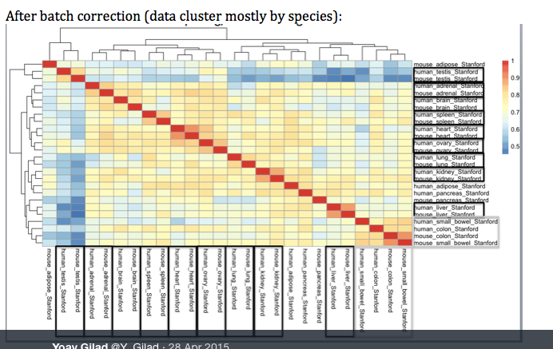
Batches can cause significant problems that (sometimes) can’t be corrected after the fact:
Even things like ‘which microarray you use’ or ‘which sequencing lane the sample is run in’ can cause batch effects:
“Following publication of their paper in Science Express, Sebastiani et al. were made aware of an inherent defect in the 610-Quad chip that they used to genotype 7% of their discovery set (60 of 801 samples) and 17% of their replication set (44 of 254 samples). This defect may have led to incorrect genotyping of some of the SNPs that Sebastiani et al. used to build their genetic classification model for exceptional longevity. “

Slide 19
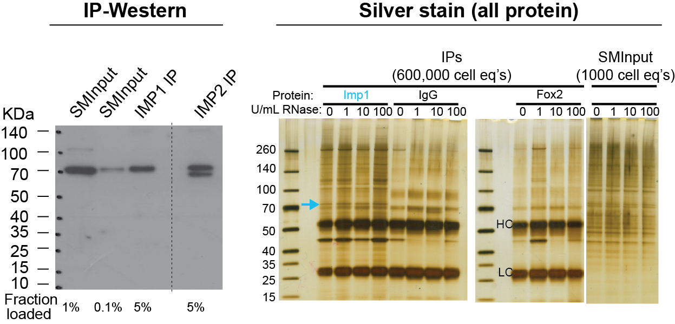
Why do ChIP/CLIP need input normalization?
IP-western indicates immunoprecipitation success…
… but there remains substantial background of other proteins after IP

Slide 20
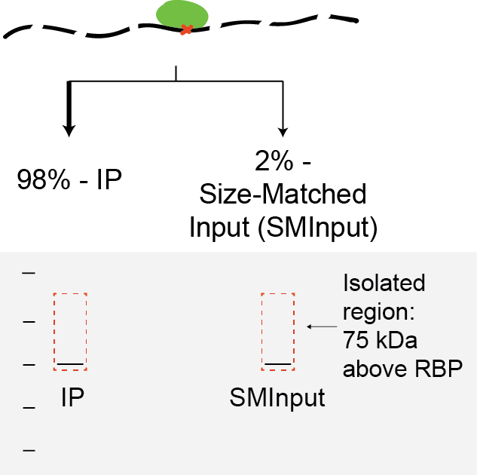
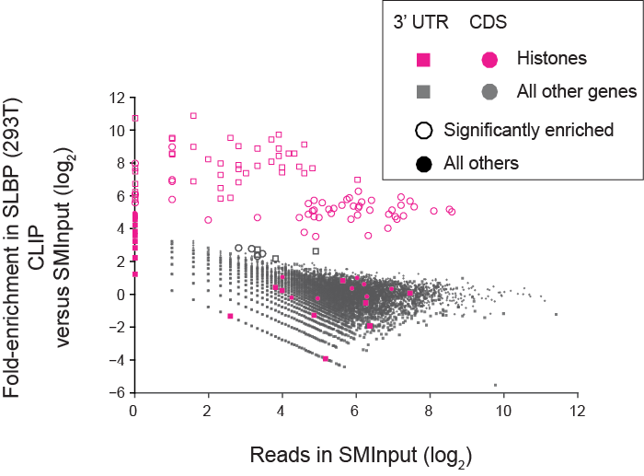
Why input normalize?
We see true signal is highly enriched above background…
… but there is mRNA background at nearly all abundant genes

Slide 21
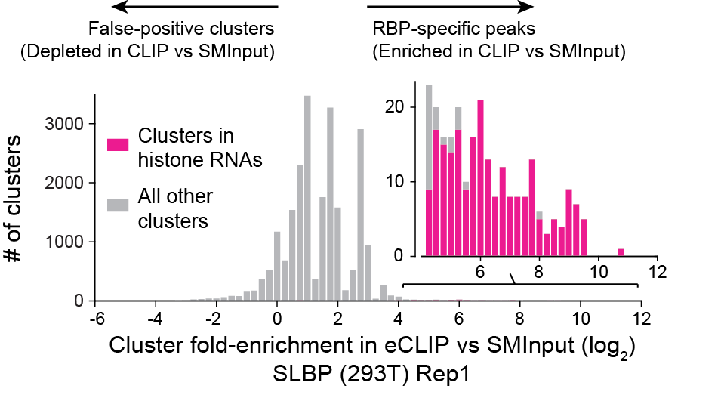
Input normalization removes false-positives and identifies confident binding sites

Slide 22
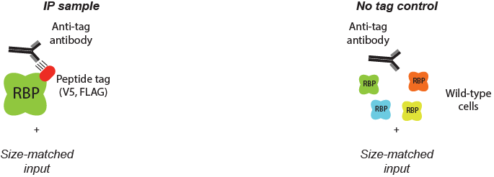
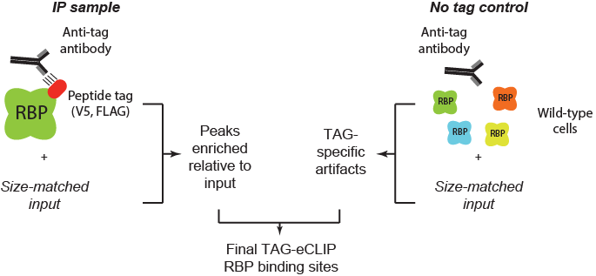
Controls are key to distinguish true from false-positive signals

Slide 23
Outline
How do I know if my dataset is ‘good’? (Q/C metrics)
RNA-seq
Binding assays (DNA: ChIP-seq, RNA: CLIP-seq)
What are key considerations for experimental design
RNA-seq – batch effects
ChIP-seq, CLIP-seq – input normalization
How can genomics data inform biology
ChIP/RNA-seq overlap to identify direct transcriptional regulation
CLIP/RNA-seq overlap identifies RNA processing regulation
Integrated analyses to reveal novel mechanisms

Slide 24
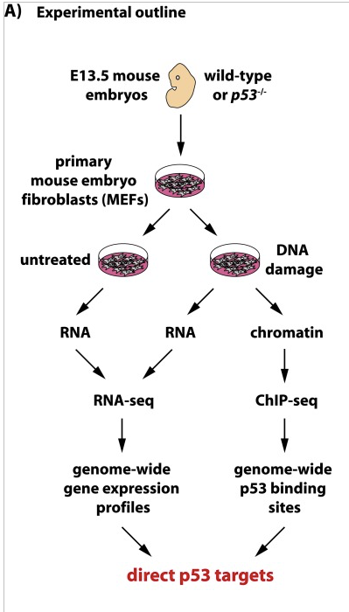
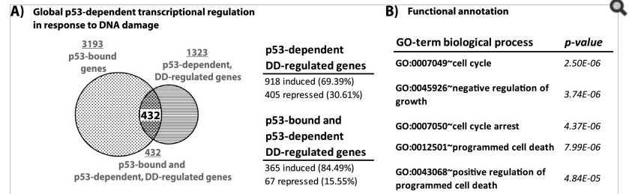
Overlapping ChIP targets with knockdown-RNAseq identifies directly regulated genes
Broz et al. 2013

Slide 25
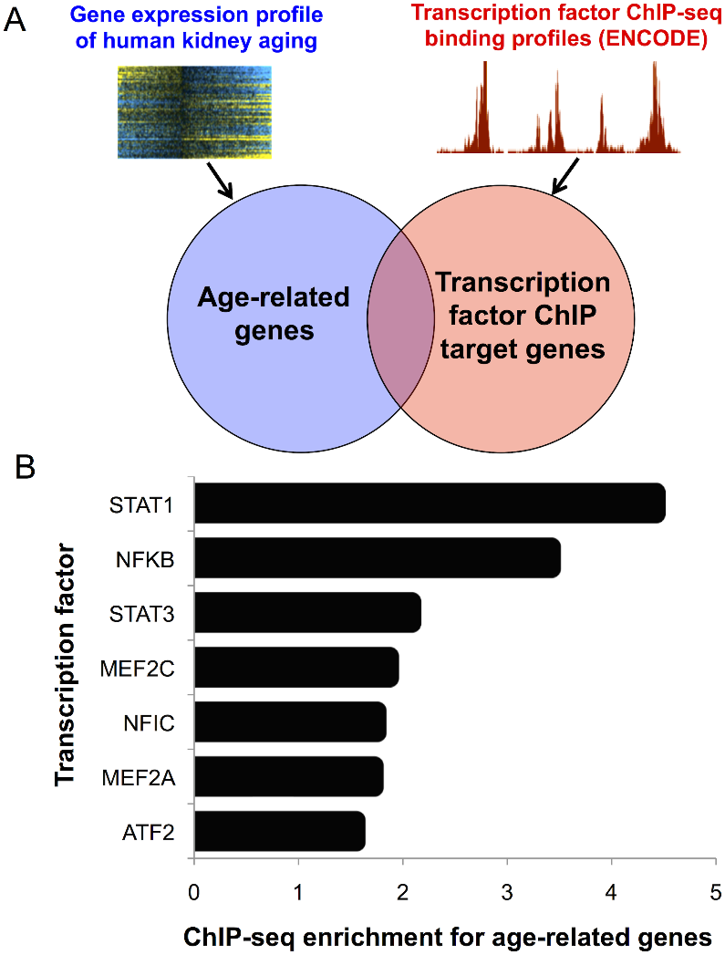
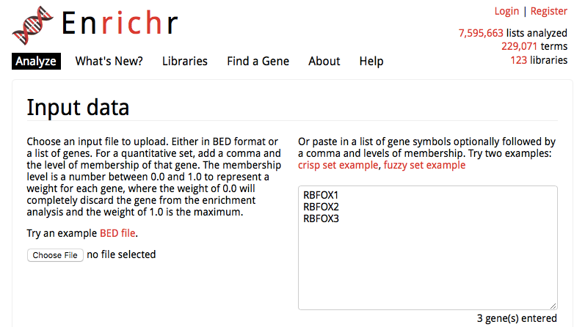
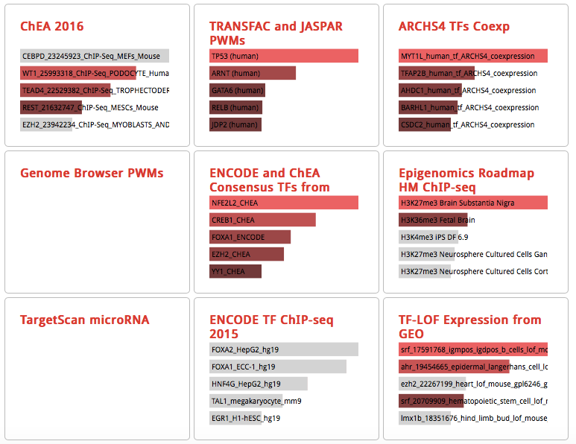
Combining RNA-seq and public ChIP-seq resources to screen for novel regulators
Ex: http://amp.pharm.mssm.edu/Enrichr/
O’Brown et al. 2014

Slide 26
An “RNA-centric” view of RBP-binding ‘in silico screen’ of a desired RNA against all CLIP datasets to identify the best-binding RBPs

Slide 27
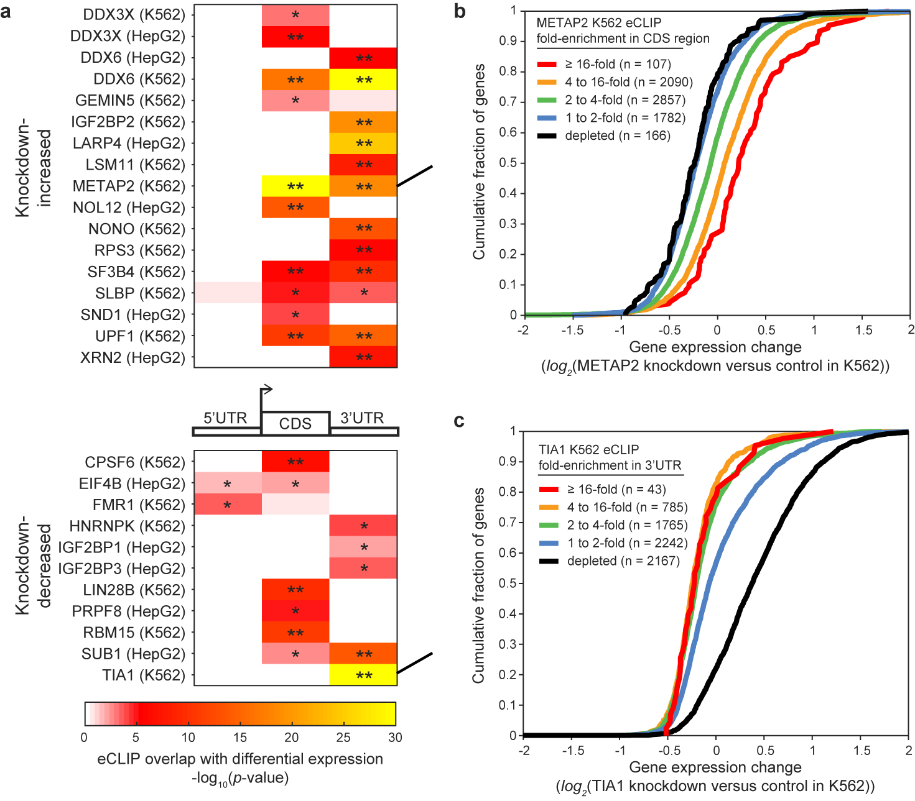
CLIP overlaps with knockdown-RNAseq identifies novel regulators of RNA stability

Slide 28
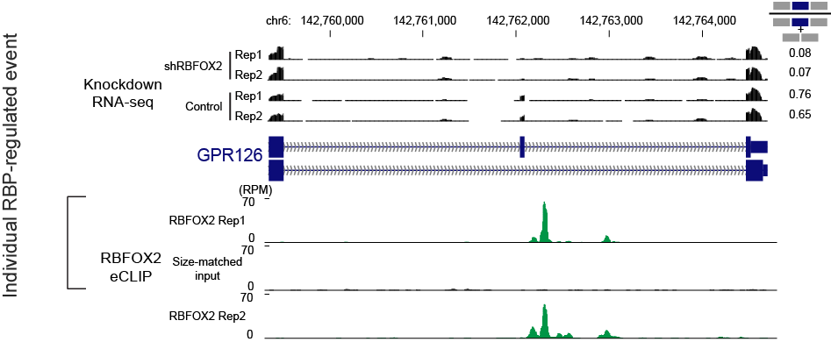
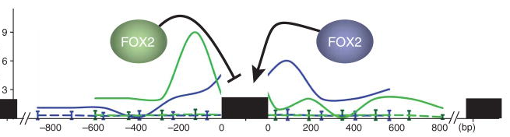
‘Splicing maps’ mark RBP regulation around alternative splicing events

Slide 29
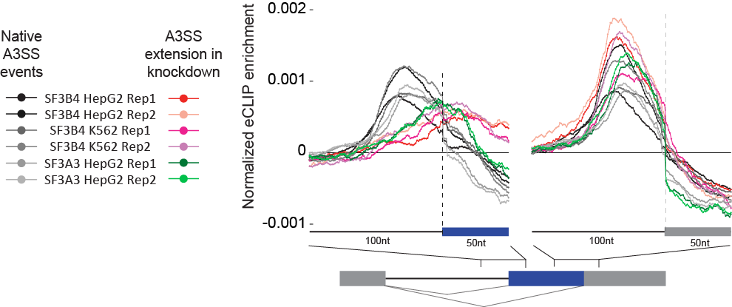
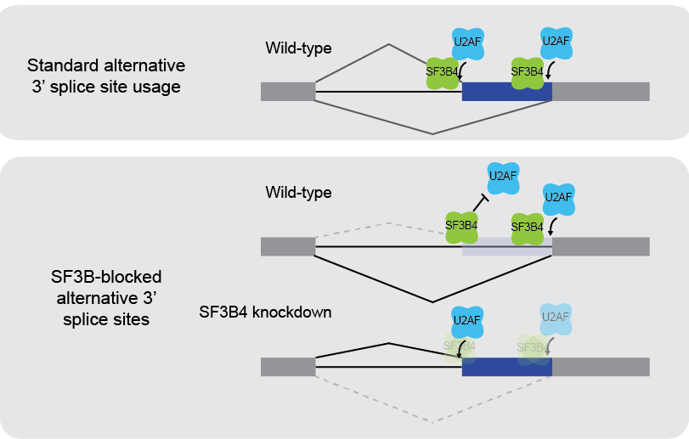
Splicing map reveals genome-wide evidence for branch point / 3’SS competition model

Slide 30
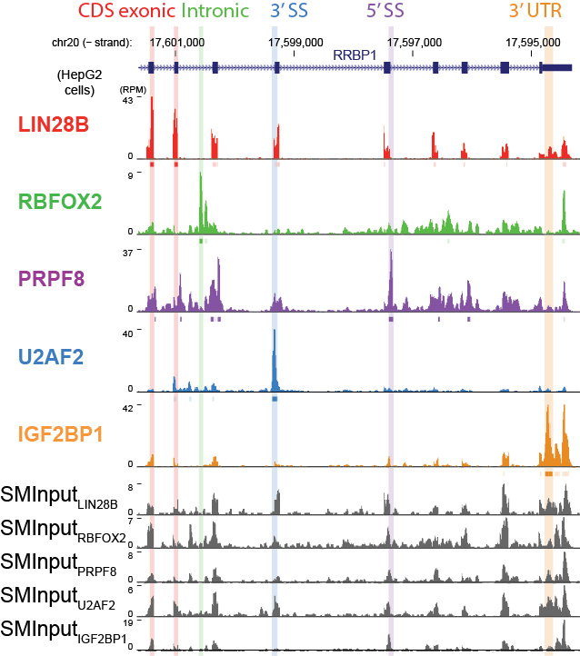
eCLIP identifies binding throughout transcripts

Slide 31
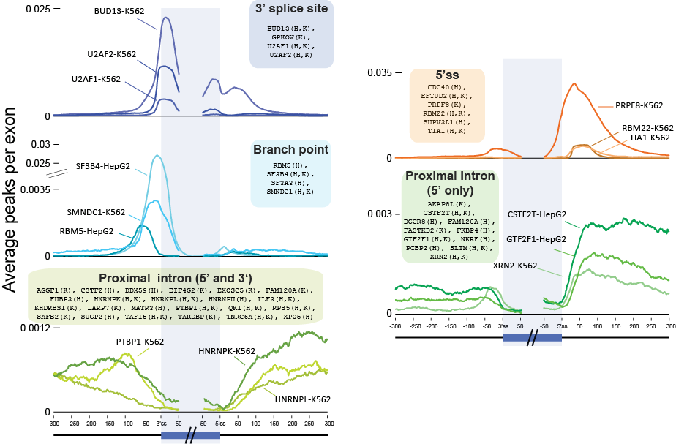
Meta-gene plots reveal RBP binding locations and suggests function

Slide 32
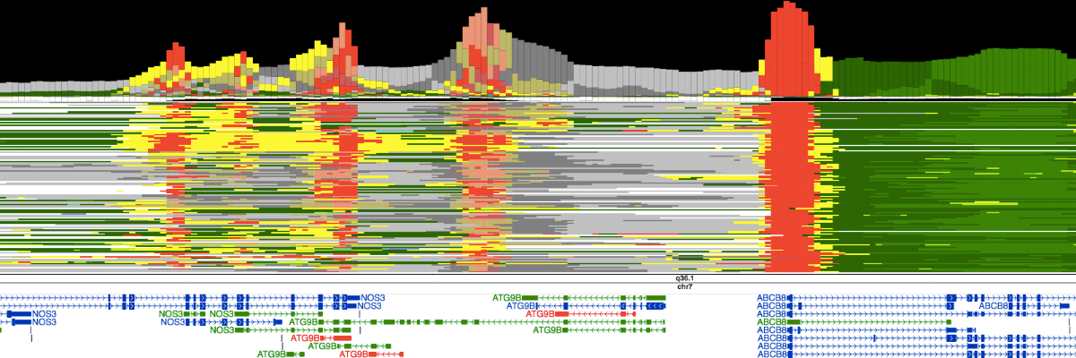
Integration of epigenetic mark ChIP-seq reveals chromatin states

Slide 33
Clustering of peak-level overlaps identifies known and novel RBP clusters

Slide 34
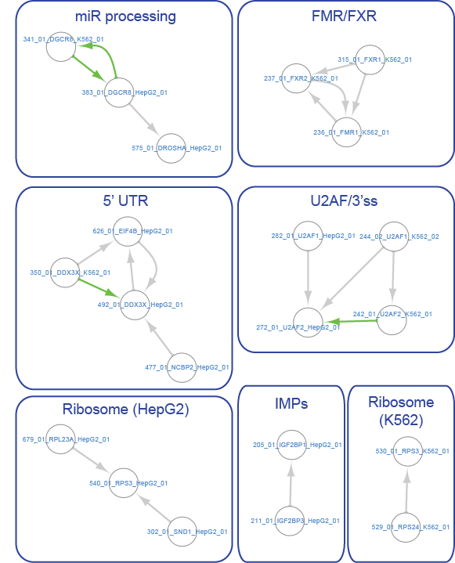
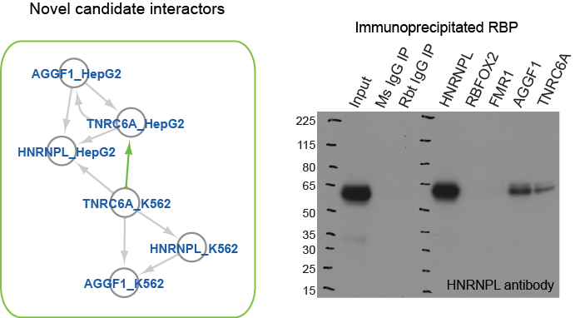
Clustering of peak-level overlaps identifies known and novel RBP clusters

Slide 35
Outline
How do I know if my dataset is ‘good’? (Q/C metrics)
RNA-seq
Binding assays (DNA: ChIP-seq, RNA: CLIP-seq)
What are key considerations for experimental design
RNA-seq – batch effects
ChIP-seq, CLIP-seq – input normalization
How can genomics data inform biology
ChIP/RNA-seq overlap to identify direct transcriptional regulation
CLIP/RNA-seq overlap identifies RNA processing regulation
Integrated analyses to reveal novel mechanisms

